Slide 1
Welcome to the PUBLIC HEARING
Good Neighbor Trail Gap PD&E Study
Hernando County, Florida
Work Program Item Segment No.: 437264-2
March 14, 2019
Notes:
The Florida Department of Transportation or FDOT welcomes you to the public hearing for the Project Development and Environment or P D and E study of the Good Neighbor Trail.
The purpose of today’s hearing is to afford attendees the opportunity to express their views on the proposed Good Neighbor Trail Gap in Brooksville. Public participation at today’s hearing is solicited without regard to race, color, religion, sex, age, national origin, handicap or family status.

Slide 2
Viewing Locations for Study Documents
Hearing being conducted in accordance with all
federal, state and local requirements
The environmental review, consultation, and other actions required by applicable federal environmental laws for this project are being, or have been, carried out by the Florida Department of Transportation (FDOT) pursuant to 23 U.S. C. §327 and a Memorandum of Understanding dated December 14, 2016 and executed by the Federal Highway Administration and FDOT.
Notes:
This public hearing is being conducted in accordance with all federal, state and local requirements. These regulations are listed on a citations board near the sign-in table.

Slide 3
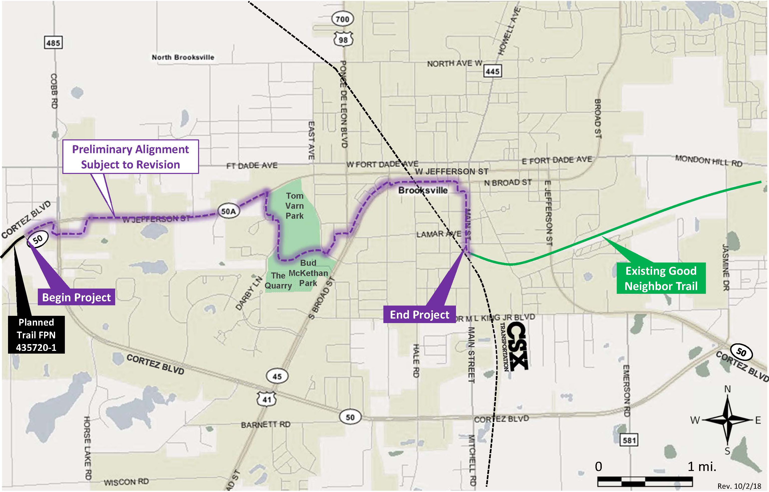
Project Location Map
Begin Project
End Project
Notes:
The Good Neighbor Gap Trail is proposed to begin along State Road 50 west of Cortez Boulevard/ Cobb Rd and extend through Brooksville, to the beginning of the existing Good Neighbor Trail, located on South Main Street. The proposed path runs through both Tom Varn and Bud McKethan Parks and also connects to downtown Brooksville. The total length of the proposed trail is currently 3.2 miles.

Slide 4
Project Purpose & Need
Project’s Purpose:
To complete a missing link in the statewide Coast to Coast Trail
Project Need:
Modal interrelationships – to provide safe, non-vehicular transportation and recreation to residents and visitors traveling within and beyond the study area
Potential Benefits:
Increased business activity, tourism, improved quality of life, improved public health and increased property values
Notes:
The purpose of the project is to complete a missing link in the statewide Coast to Coast Trail. This project will help provide safe, non-vehicular transportation and recreation to residents and visitors traveling within and beyond the study area. Potential project benefits include increased business activity, tourism, improved quality of life, improved public health and increased property values.

Slide 5
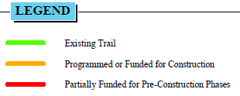
The Coast to Coast Trail
Good Neighbor Trail Gap in the Coast to Coast Trail
Notes:
The proposed trail will complete a 3.2 mile Gap in the Coast to Coast Trail. When completed, the Coast to Coast Trail will be 250 miles long, spanning the state from coast to coast.

Slide 6
Previous MPO Alternatives Analysis
Notes:
An earlier corridor and alignment study was completed in 2016 for the Hernando Citrus Metropolitan Planning Organization or M-P-O. The study was conducted and approved and it serves as the basis for the PD&E.

Slide 7
Current Proposed Trail Alignment
Cobb Rd
W. Jefferson St
Tom Varn Park
S. Main St
S. Broad St
Cortez Rd
Notes:
The proposed alignment from the current PD&E study deviates slightly from the MPO’s study preferred alignment in several areas. The deviations are at locations circled in yellow. These deviations were due to the result of the need to minimize right of way and business impacts and constructability issues. These differences are documented in the draft Preliminary Engineering Report which is on display at today’s hearing.

Slide 8
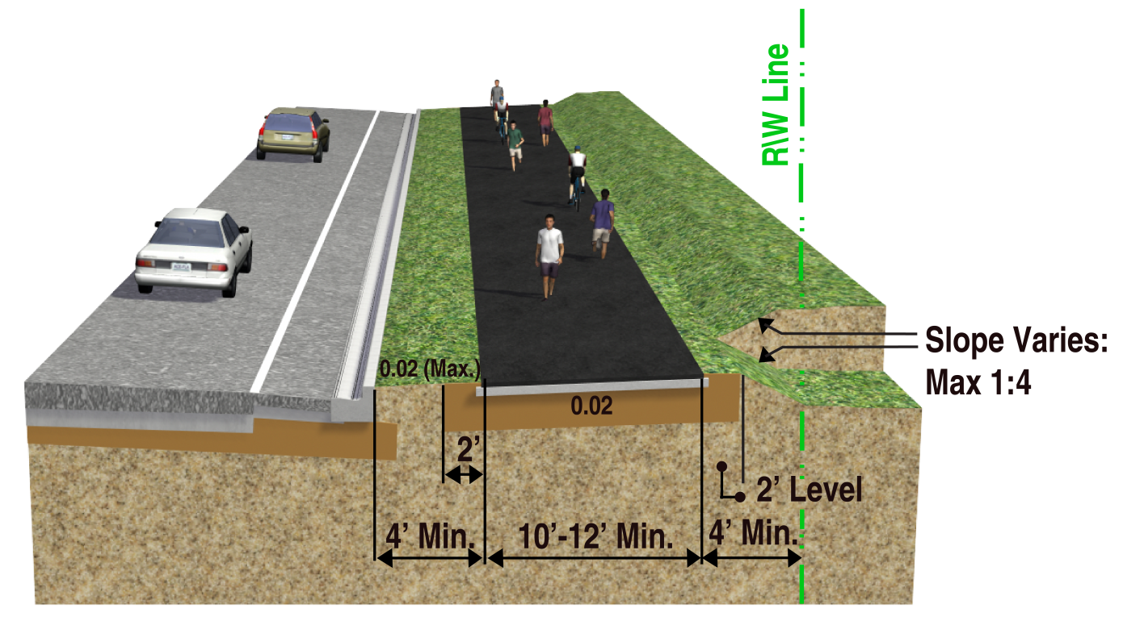
Trail Typical Sections
Urban Trail Typical Section Example
Notes:
Depending on the location along the trail, various types of trail typical sections will be utilized. This is an example of an urban trail typical section, which will be used in many areas along the proposed trail where the existing roadway has curb and gutter.

Slide 9
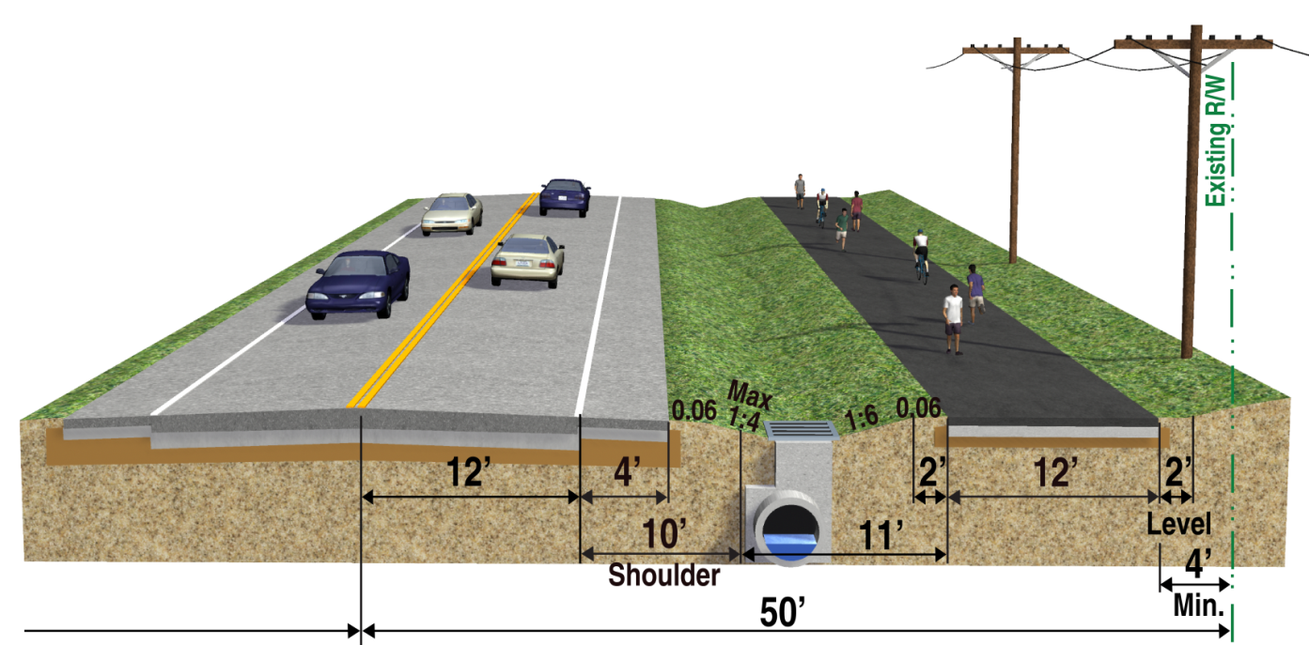
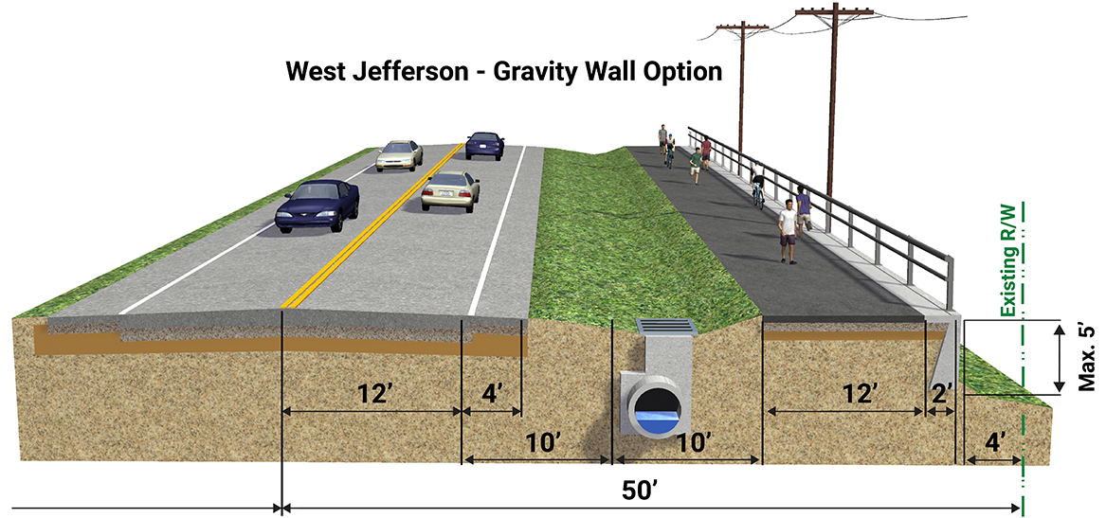
Trail Typical Sections
Notes:
These are examples of rural trail typical sections, which will be used along West Jefferson Street, east of Cobb Road, where the existing right of way is wider and drainage is handled by ditches.

Slide 10
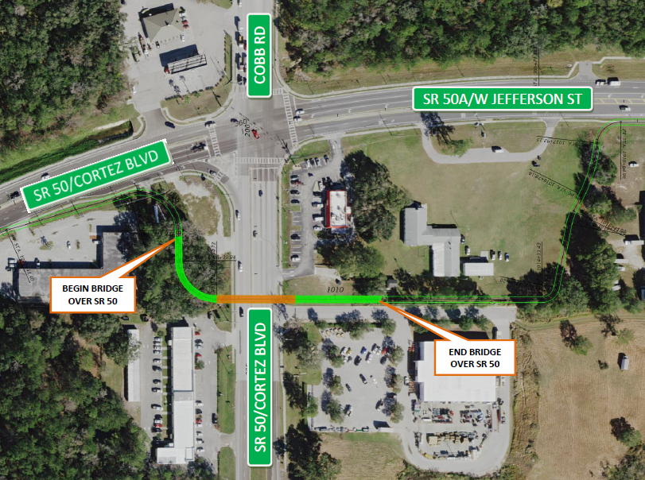
Proposed Trail Bridge over Cortez Blvd
Notes:
The trail is currently proposed to cross Cortez Boulevard on an overpass south of the intersection of SR 50 and Cobb Road at Whitfield Avenue.

Slide 11
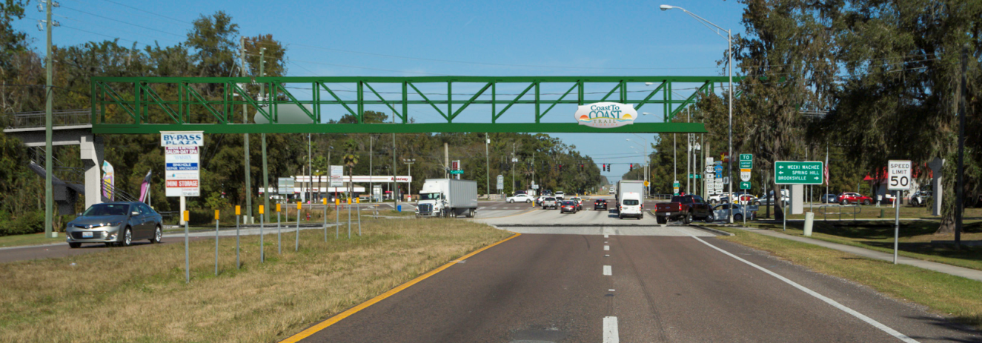
Proposed Trail Bridge over Cortez Blvd
Notes:
This is a computer rendering of the recommended bridge over Cortez Boulevard, looking north. There are stairs near the left side of the photo which connect the sidewalk on Cortez Boulevard to the trail bridge.

Slide 12
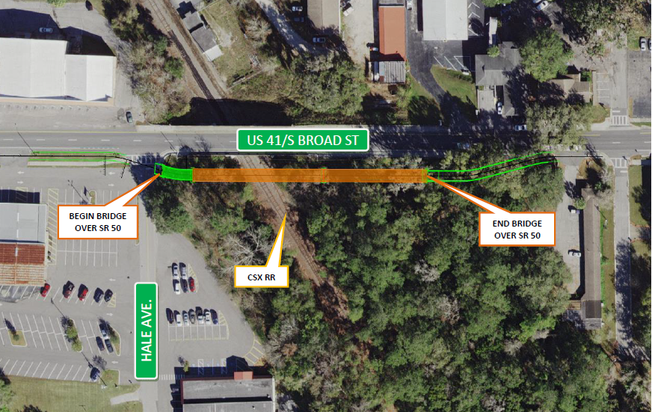
Proposed Bridge over CSX Railroad
Notes:
An overpass is also proposed to be constructed over the CSX rail line, adjacent to the south side of Broad Street just east of Hale Avenue.

Slide 13
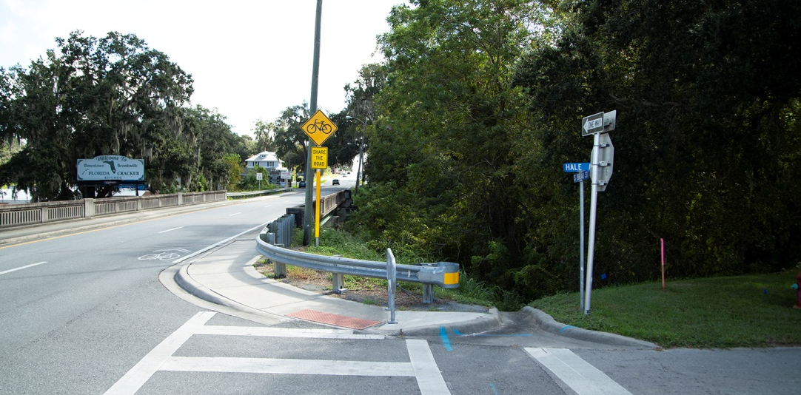
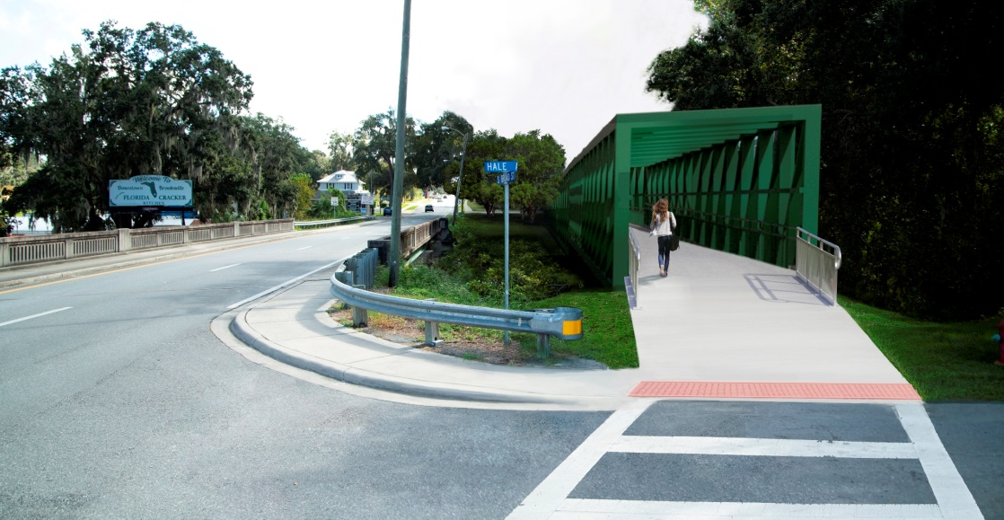
West Approach at CSX Crossing
← Existing View Looking East
← Proposed View Looking East
Notes:
The bottom image is a computer rendering of how a steel truss bridge structure might look at this location.

Slide 14
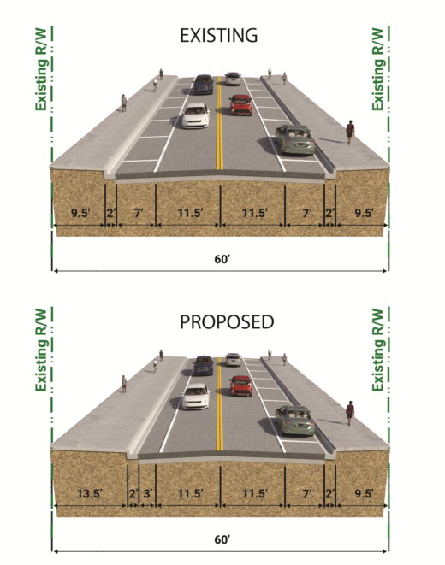
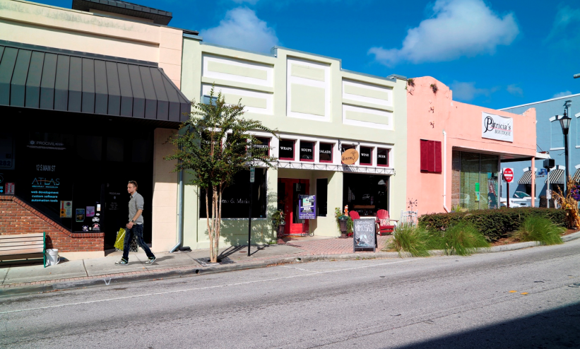
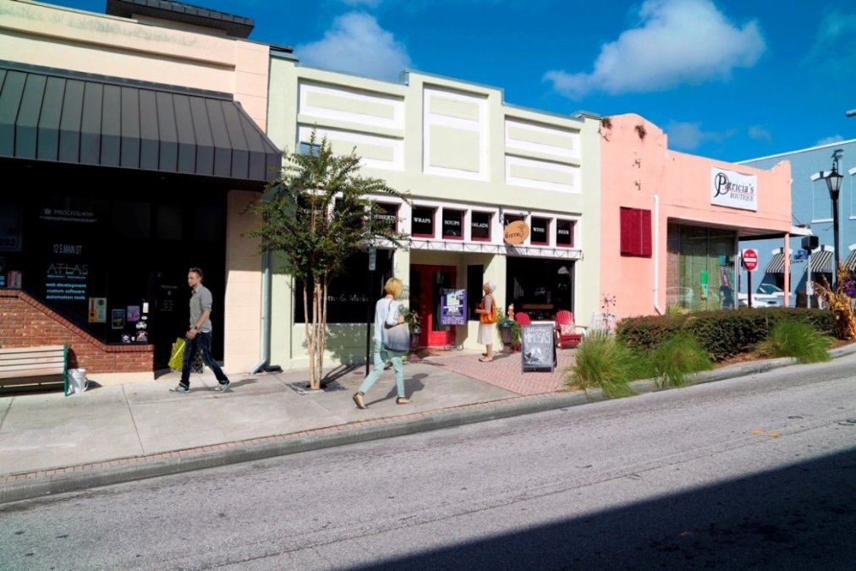
Proposed Trail “Spur” on Main South of Broad St
Existing Parking Lane
Wider Sidewalk
Notes:
A trail spur is proposed on South Main Street between Broad Street and Liberty Street, connecting the trail to downtown. The proposed trail would widen the existing sidewalk by removing the parking lane on the west side of Main Street. A similar spur is proposed on Broad Street between North Orange Avenue and South Main Street.

Slide 15
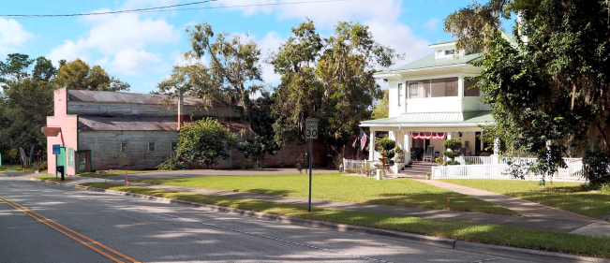
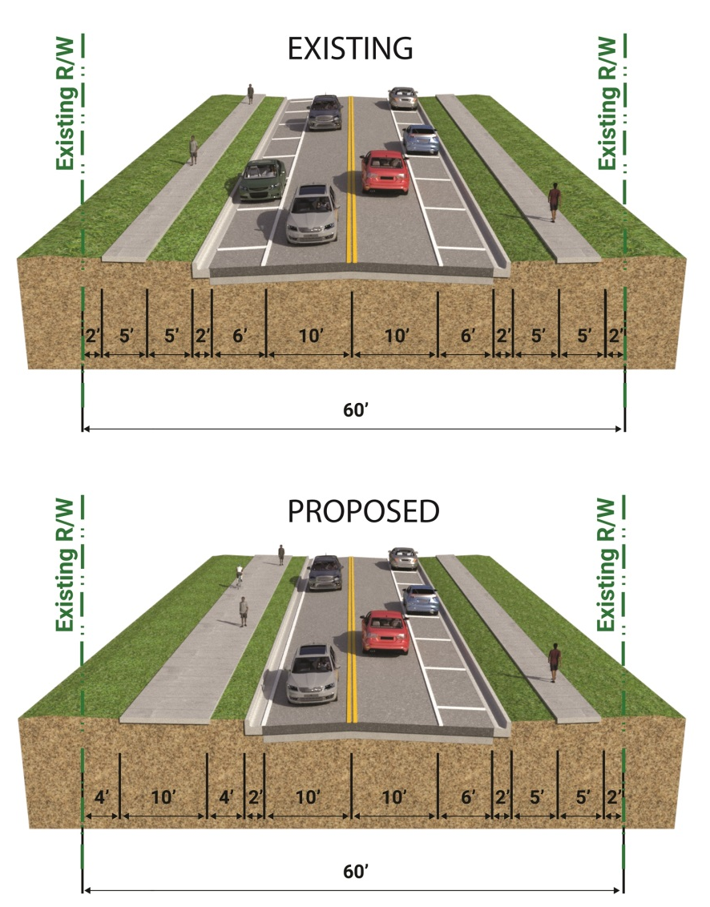
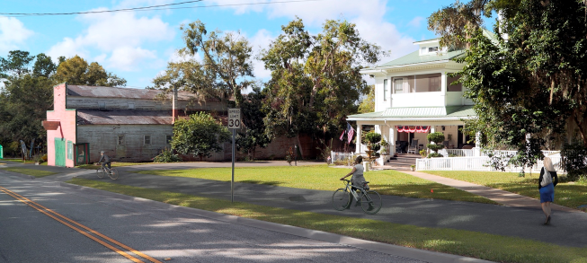
Typical Section on Main South of Liberty St
(Both views looking north)
Existing View at 140 South Main Street Looking Southwest
Trail Rendering – Looking Southwest
Notes:
On Main Street south of Liberty Street, the existing parking lane on the west side of the roadway is proposed to be eliminated to accommodate a 10 foot trail.

Slide 16
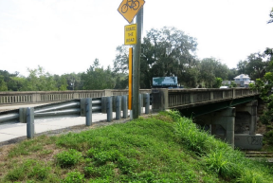
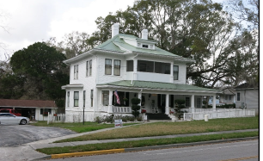
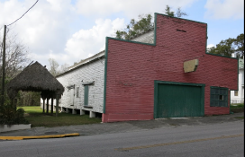
Environmental Issues
Historic Resources
A Cultural Resource Assessment Survey (CRAS) Report was prepared to
Identify any archaeological sites and historic resources and
to assess their eligibility for listing in the National Register of Historic Places
Four Historic Resources were identified:
Brooksville Overpass over CSX Railroad
The Downtown Brooksville Historic District
140 South Main Street
Brooksville Lumber
Draft Section 106 Consultation Case Study Report (December 2018) suggests “No Adverse Effect” to these resources
Brooksville Overpass
140 South Main St
Brooksville Lumber
Notes:
A Cultural Resource Assessment Survey (or CRAS) Report was prepared to identify any archaeological sites and historic resources and assess their eligibility for listing in the National Register of Historic Places. As a result of the CRAS, four historic resources were identified. These included the Brooksville Overpass over the CSX railroad, the Downtown Brooksville Historic District, 140 Main Street, and Brooksville Lumber. In addition, a Draft Section 106 Consultation Case Study Report was prepared to assess the expected effects of the proposed trail project on these historic properties. The Draft report’s findings suggest No Adverse Effect to the historic resources identified.

Slide 17
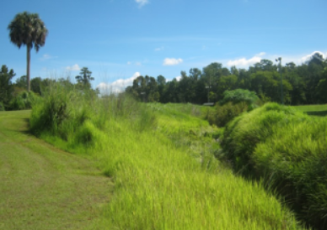
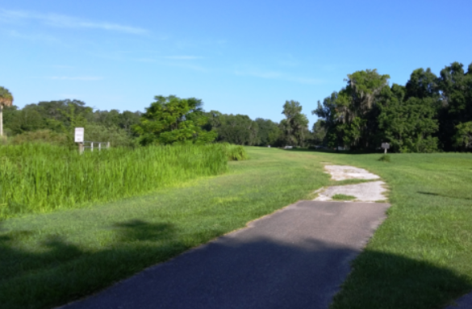
Environmental Issues
Section 4(f) resources
Tom Varn and Bud McKethan Parks are considered potential Section 4(f) Resources -- protected by federal laws
These parks were excepted from the requirement for Section 4(f) evaluation since:
the city previously dedicated a proposed trail ROW through these parks, and
Transportation Enhancement Projects are excepted from Section 4(f) action in this type situation
Notes:
The federal study process requires addressing involvement with public park lands which are considered as potential Section 4(f) resources and protected by federal laws. Potential impacts to Tom Varn and Bud McKethan Parks were excepted from the requirement for Section 4(f) evaluation since the city previously dedicated a proposed trail right of way through these parks. In addition, transportation enhancement projects are excepted from Section 4(f) action for this type of project where the proposed improvement is intended to enhance the qualities of the park.

Slide 18
Environmental Effects
Summary of Potential Environmental Effects
Environmental Subject | Effects of Trail Construction for Recommended Alignment
Number of Business/Residential Relocations | 0
Right of Way Required | 1.4 acres
Number Parcels with ROW Acquisition | 12
Number of Historic Sites | No adverse effects expected
Section 4(f) Properties Involvement | Tom Varn & Bud McKethan Parks (excepted from Evaluation Requirements)
Wetlands & Surface Waters | 0.03 acres
Noise and Air Quality Effects | No effects
Threatened/Endangered Species | No adverse effects
No. Potential Contaminated Sites | 17 sites rated as medium or high risk
Notes:
An evaluation matrix is on display at today’s hearing. This chart shows the expected environmental effects portion of the matrix. Overall the expected environmental effects of this project are very minimal, and potential benefits of the proposed trail could include improving safety, community connectivity and enhanced quality of life, economic development and increased property values through greater access and mobility.

Slide 19
Right of Way (ROW) Acquisition
ROW Acquisition is Required at Yellow Outlined Areas:
Cobb Rd
Tom Varn Park
W. Jefferson St
S. Main St
S. Broad St
Cortez Rd
Preliminary Estimate of ROW Costs and Impacts
No. Parcels | Total Area (acres) | Est. ROW Cost
12 | 1.4 | $1.5 million
Note: Per policy, FDOT will not utilize eminent domain (“condemnation”) for ROW acquisition; therefore, the alignment could change during the final design phase.
Notes:
Right of way acquisition will be required in several areas along the proposed trail alignment; these areas are outlined in yellow on the map shown here. More detailed information is shown on the conceptual design plots on display as well as in the concept plans.

Slide 20
Project Cost Estimate
Estimated Project Costs
The recommended build alternative is estimated to cost approximately $ 19.4 million in today’s dollars.
Component | Fiscal Year Funded | $Millions
Design & Construction Inspection | FY 2019 | 3.6
ROW Acquisition | FY 2019 | 1.5
Construction | FY 2022 | 14.3
Totals |  | 19.4
Notes:
We are currently in the PD&E study and final design phases. Right of way acquisition is funded to begin in this fiscal year 2019. Construction is funded to begin in fiscal year 2022.
The recommended build alternative is currently estimated to cost approximately _19.4_ million in today’s dollars.

Slide 21
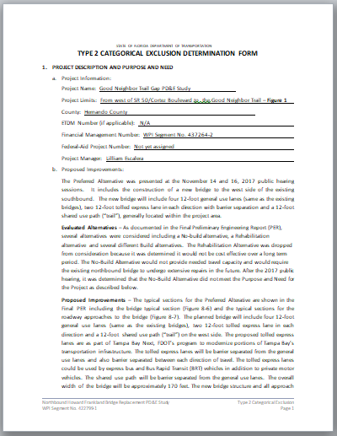
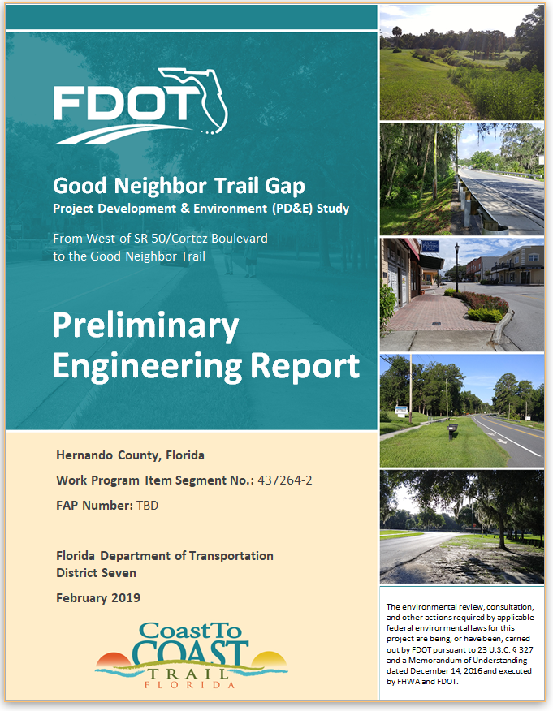
Following this Hearing
Project Schedule
Public Hearing | March 14, 2019
Updated Concepts | Summer 2018
Finalized PD&E Documents | Spring 2019
PD&E Study Complete | Summer 2019
The study will be completed by Fall 2019.
Notes:
Following today’s hearing, the Project Team will review all public input. They will document the preferred alternative, finalize the study documents, and complete the P D and E study. In the next few months, the final documents will be submitted to FDOT’s Office of Environmental Management for review and approval, on behalf of the Federal Highway Administration. We expect the P D and E study to be completed by late summer of this year.

Slide 22
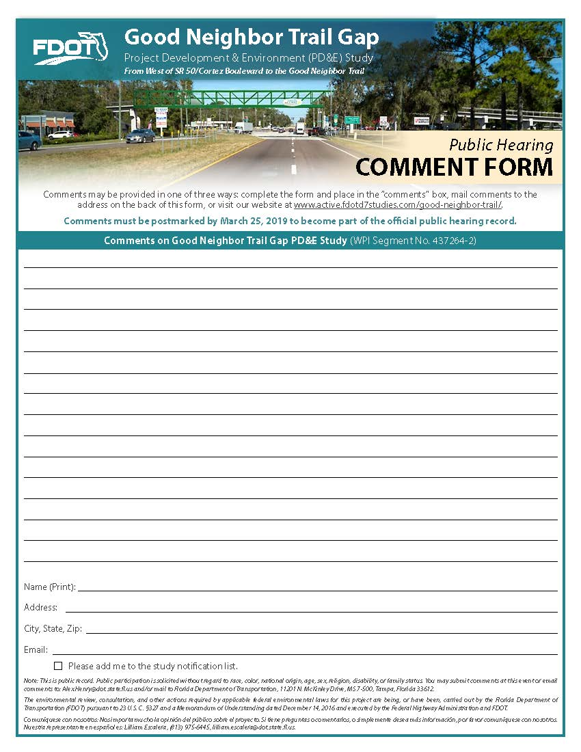
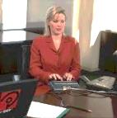
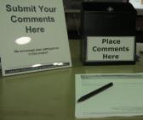
Opportunities for Input
Provide Comments
Court Reporter
Directly at table
Public Statement at the Formal Portion
Comment Form
Comment page on project website www.active.fdotd7studies.com/good-neighbor-trail/
Comment form by mail
Florida Department of Transportation – District Seven 11201 N. Malcolm McKinley Drive, MS 7-500
Tampa, FL 33612
Must be postmarked by
March 25, 2019
to become part of the public hearing record
Notes:
This public hearing is an opportunity for you to ask questions and offer comments on this study. Project representatives are available to provide more detailed information and to address your questions.
There are several ways to comment as part of the public hearing record. All comments received, will be reviewed and considered in the study analysis, regardless of how they are submitted.
You can speak directly with the court reporter at this hearing
You may make a statement during the formal portion of today’s hearing
You may complete the Comment Form provided and drop it in one of the comment boxes today
You may input comments onto the comment page of the project website, and
You may mail written comments to the address listed on the back of the form. Please return this form postmarked by March 25, 2019 so your comments can become part of the PD&E study public hearing record.

Slide 23
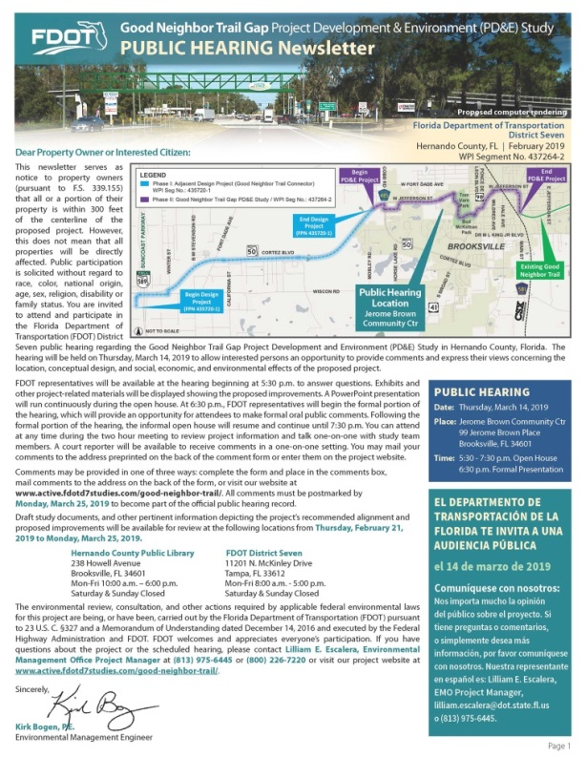
Project Website
For Project Information Visit:
www.active.fdotd7studies.com/good-neighbor-trail/
Hernando County Public Library
238 Howell Avenue Brooksville, FL 34601
(352) 754-4043
Florida Department of Transportation District Seven
11201 North McKinley Drive
Tampa, FL 33612
(813) 975-6000
Documents on display from
February 21, 2019 to March 25, 2019
Notes:
Copies of today’s hearing materials will be available on the project’s website.
Draft study reports are available for review at this hearing and have been on public display at a public library in Hernando County and at the FDOT’s District Seven office.

Slide 24
Thank you for Participating!
For Project Additional Information Visit:
www.active.fdotd7studies.com/good-neighbor-trail/
Remember to be Alert Today, Alive Tomorrow.
Safety doesn’t happen by accident.
Notes:
The Florida Department of Transportation thanks you for your participation at this public hearing and for your interest in this planned project. For additional information visit the project website at www.active.fdotd7studies.com/good-neighbor-trail/. Remember to be Alert Today, Alive Tomorrow. Safety doesn’t happen by accident.

Slide 25
Please take time to view the exhibits in the Main Area and provide us your comments
Next show will begin in 2 minutes

Slide 26
Please take time to view the exhibits in the Main Area and provide us your comments
Next show will begin in 1 minute

Slide 27
Please take time to view the exhibits in the Main Area and provide us your comments
Next show will begin in 10 seconds

Slide 28
Please take time to view the exhibits in the Main Area and provide us your comments
Next show will begin in 5 seconds

