Slide 1


Welcome
US 92 (SR 600)
PROJECT DEVELOPMENT & ENVIRONMENT
(PD&E) STUDY RE-EVALUATION
FROM I-4 TO COUNTY LINE ROAD
Notes:
Welcome to the Public Hearing for the US 92 Project Development and Environment, or P D and E, Study Re-evaluation.

Slide 2
PD&E STUDY PROCESS
Re-evaluation of the original PD&E Study approved by the Federal Highway Administration on March 24, 1994
Focuses on changed conditions
Re-evaluation of proposed improvements includes:
  Costs
  Engineering aspects
  Environmental aspects
  Public and agency input
Notes:
A PD&E Study was originally completed for this project in March of 1994. Due to changes in design standards and existing conditions, the original PD&E Study is being re-evaluated. The purpose of this study is to determine the location and conceptual design of the preferred roadway improvements, as well as associated social, economic, and environmental effects of the improvements. At tonight’s hearing, we’ll present the findings of the PD&E Study Re-evaluation for US 92.

Slide 3
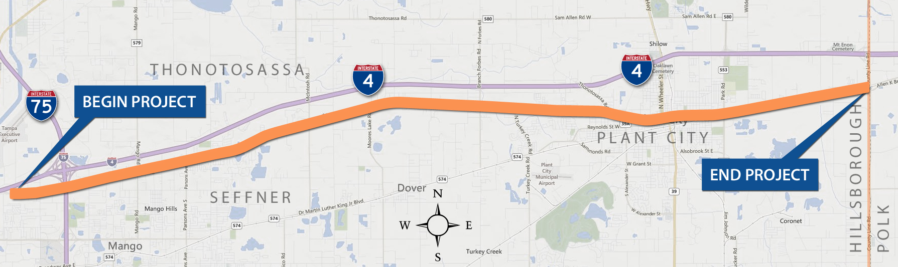


PROJECT LOCATION
Project begins at Garden Lane (East of I-4)
Project ends at County Line Road
Re-evaluation of original 1994 PD&E Study
Approximately 18.1 miles
18 miles
Notes:
The Florida Department of Transportation, in cooperation with the Federal Highway Administration, is holding this hearing to provide you with information and to get your comments about this study. The study corridor limits are from east of Interstate 4 at Garden Lane to east of County Line Road in Hillsborough County, a distance of approximately 18.1 miles.

Slide 4
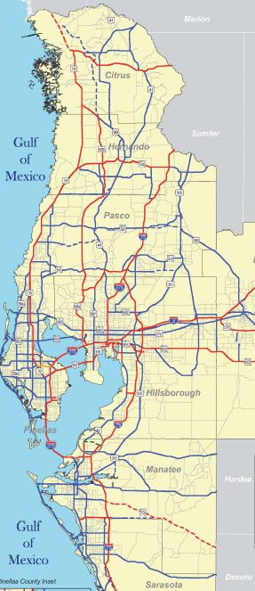
TAMPA BAY AREA REGIONAL TRANSPORTATION NETWORK
US 92 is:
A major east-west roadway through Hillsborough County
An important facility in the Tampa Bay area regional transportation network
Notes:
US 92 is a major east-west arterial of regional significance that parallels I-4 and State Road 574 in Hillsborough County. Within the study area, US 92 plays a significant role in connecting eastern Hillsborough County to the Tampa Bay region.

Slide 5
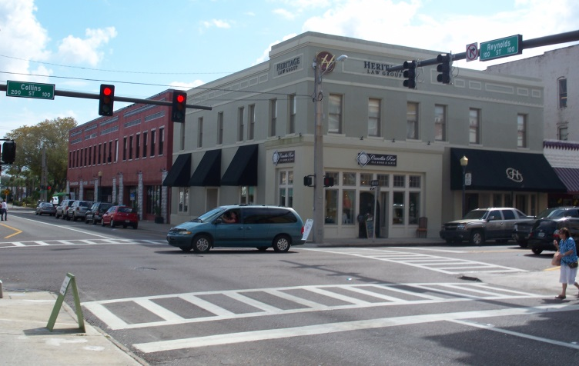
PROJECT DESCRIPTION
Key Project Facts:
Project will increase capacity and improve safety
Four-lane improvement from Garden Lane to Mobley Street and from Park Road to County Line Road
No-build through Plant City
  Mobley Street to Maryland Avenue
  Upcoming Resurfacing project
    Minor Improvements
Notes:
Aligning with the primary goal of FDOT, this project is focused on improving safety while also improving facility operation. Along the corridor there will be various safety and operational improvements made to this vital highway. Both to the east and west of downtown Plant City there are segments that will be converted from a two-lane to a four-lane road improving capacity. As with the original study, Downtown Plant City, from Mobley Street to Maryland Avenue, will be considered a no-build segment, with no improvements made. FDOT does have a resurfacing project programmed for this segment that will include sidewalk and safety enhancements.

Slide 6
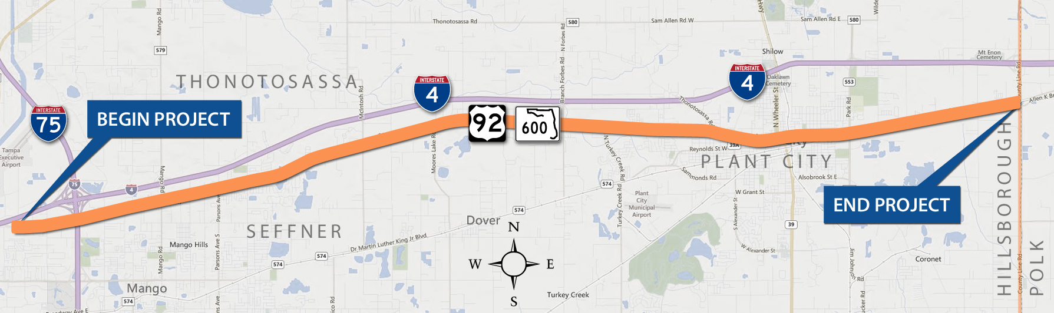
EXISTING CONDITIONS
1. Thonotosassa Road to Mobley Street
2. Mobley Street to Gordon Street
3. Gordon Street to Park Road
4. East of Park Road to East of County Line Road
Notes:
The existing roadway for US 92 from Garden Lane to Thonotosassa Road is generally a two-lane undivided rural roadway. Sidewalks or boardwalks have been added along one or both sides of the highway.
From Thonotosassa Road to Mobley Street, the roadway transitions from a two-lane to a four-lane facility.
Then from Mobley Street to Gordon Street, US 92 is divided and forms a two-lane one-way pair system.
From Gordon Street to Park Road, US 92 is a four-lane divided urban roadway with curb and gutter. There is a 5-foot sidewalk along the north side of the road.
From east of Park Road to east of County Line Road, US 92 is a rural facility with two 12-foot-wide lanes.

Slide 7
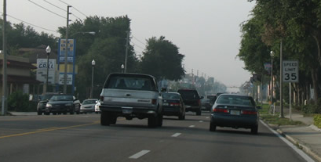
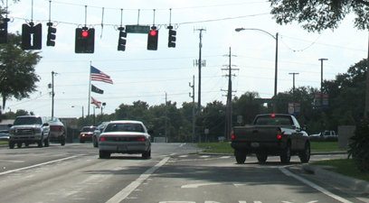
PROJECT NEED
Capacity
  Future estimated traffic volumes will cause US 92 to operate below desired standards
    18,100 to 39,300 vehicles/day by year 2040
Notes:
As identified in the original PD&E Study, the need for the project is based on capacity deficiencies, consistency with transportation plans, safety, and socioeconomic demand.
Based on the growth projected to occur within the corridor, US 92 is projected to have future traffic volumes ranging from approximately 18,100 to 39,300 vehicles per day by year 2040. These volumes would exceed the roadway capacity for existing US 92 within the project limits. The proposed widening to four lanes will allow US 92 to meet future travel demand at an acceptable level of service and allow US 92 to continue to serve as an important regional arterial.

Slide 8
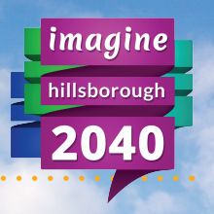
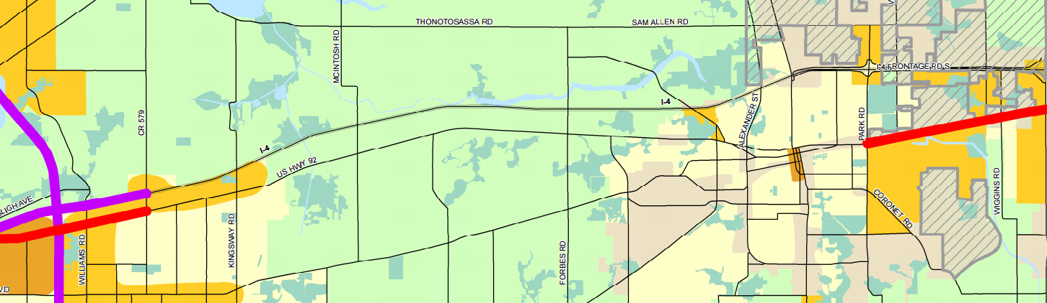
Transportation Planning
  US 92 from US 301 to CR 579 (Mango Road) and from Park Road to County Line Road
    Included in the Imagine 2040: Hillsborough County MPO Long Range Transportation Plan Cost Feasible Plan
Notes:
The project is consistent with local planning. The segments of US 92 from US 301 to County Road 579 and from Park Road to County Line Road have been identified as cost feasible projects in the Imagine 2040: Hillsborough Long Range Transportation Plan. These segments have also been included in the State Transportation Improvement Program and the Hillsborough County Metropolitan Planning Organization’s Transportation Improvement Program for design.

Slide 9
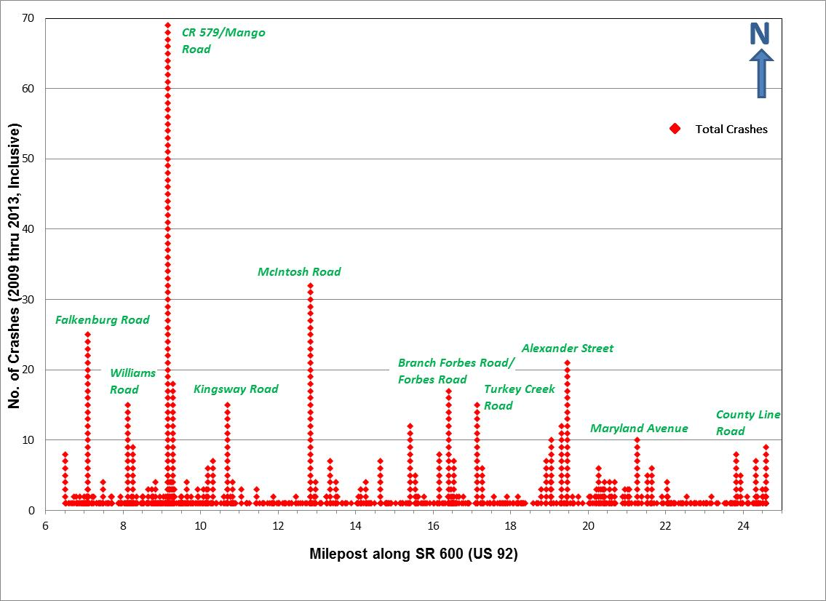
PROJECT NEED
Distribution of Crashes (2009-2013) by Milepost along US 92
East of I-4 to East of County Line Road
1,209 crashes
14 fatalities
The average five-year crash rate is higher than the statewide average
Notes:
Crash data along US 92 within the project limits was obtained from FDOT for the most recent five-year period, from 2009 through 2013. There were one thousand two hundred and nine crashes reported during the five-year period which involved numerous injuries and fourteen fatalities. The average crash rate over the entire length of the US 92 study corridor is higher than the statewide average crash rate for two of the segments. Many of the crashes on US 92 are types that are associated with congestion. The proposed widening of US 92 and the addition of turn lanes at intersections is expected to improve safety along the corridor.

Slide 10
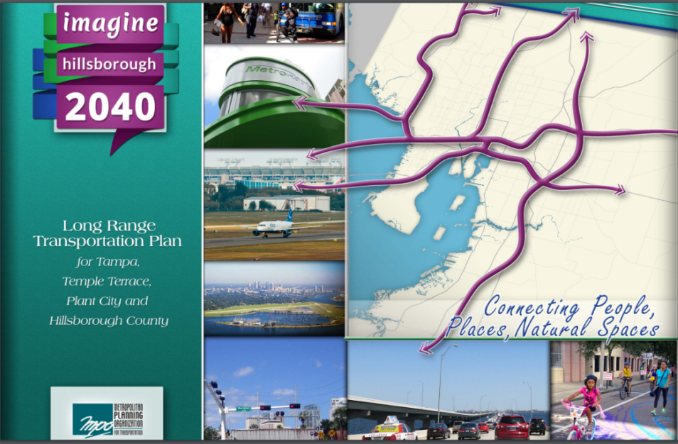
PROJECT NEED
Socioeconomic Demand
  Projected regional growth between 2010-2040 will increase traffic
    Employment increase of 56%
    Population increase of 48%
Hillsborough MPO LRTP
Notes:
The Hillsborough County MPO’s 2040 LRTP socioeconomic projections estimate an employment increase of 56% and a population increase of 48% for Hillsborough County between the year 2010 and year 2040. As a result, traffic on US 92 is expected to increase due to projected population and employment growth both along the corridor and in the region.

Slide 11
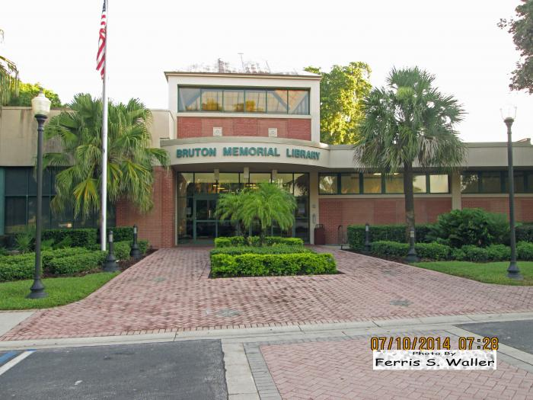
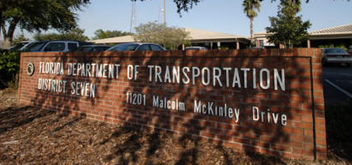
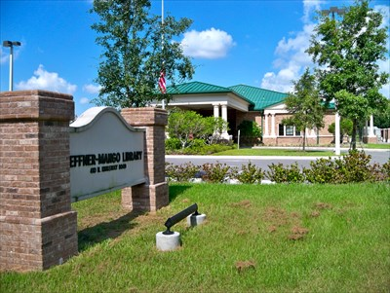
VIEWING LOCATION FOR STUDY DOCUMENTS
This public hearing is being conducted in accordance with all federal, state and local requirements. These regulations are listed on a citations board near the sign-in table.
Bruton Memorial Library
302 West McLendon Street
Plant City, Florida 33563
(813) 757-9215
FDOT District Seven
Planning & Environmental
Management Office
11201 N. McKinley Drive
Tampa, FL 33612
(813) 975-6445
Seffner-Mango Branch Library
410 N. Kingsway Road
Seffner, FL 33584
(813) 273-3652
Documents on display from
November 8, 2016 to December 19, 2016
Notes:
This public hearing is being conducted in accordance with all federal, state, and local requirements. Draft study reports are available for review at this hearing and have been on public display at two local libraries as well as the FDOT District Seven office. The display period began on November 8th and will continue until December 19th 2016. The project newsletter shows the library hours.

Slide 12
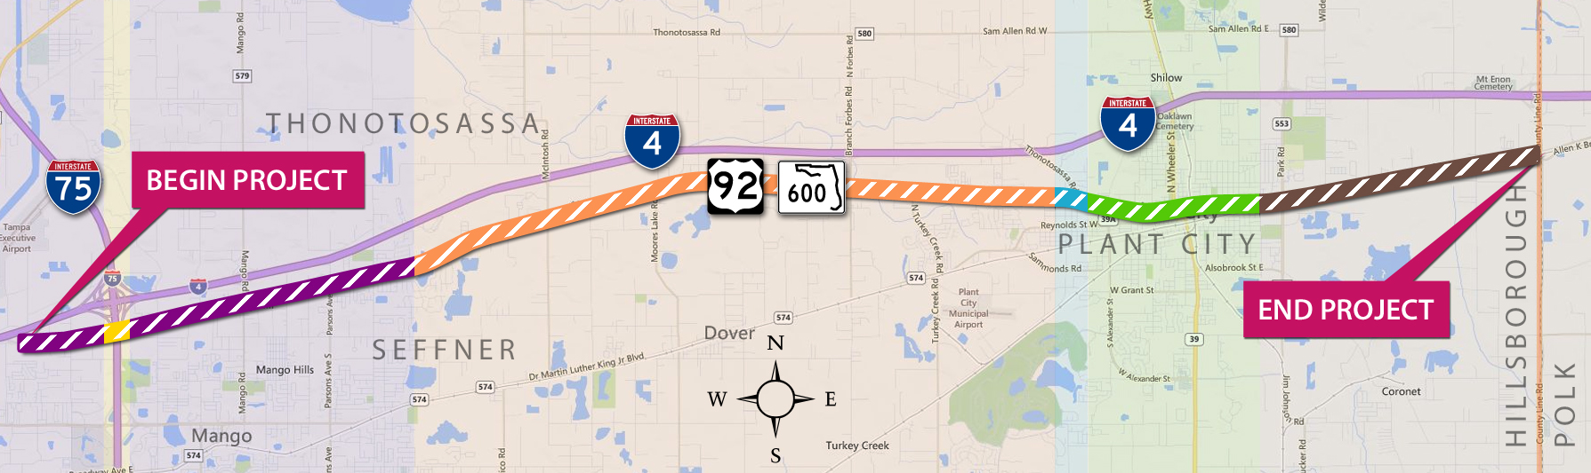


RECOMMENDED BUILD ALTERNATIVE
Four primary typical sections are proposed for the project:
  Garden Lane to East of Crow Wing Drive (purple area)
  East of Crow Wing Drive to Edwards Street (orange area)
  Edwards Street to Mobley Street (blue area)
  West of Park Road to County Line Road (brown area)
No-Build alternative
  Mobley Street to Maryland Avenue (green area)
Notes:
There are four primary typical sections for the project that are represented by the different colors on the map. The no-build segment, highlighted in green on the map will not have any improvements made.

Slide 13
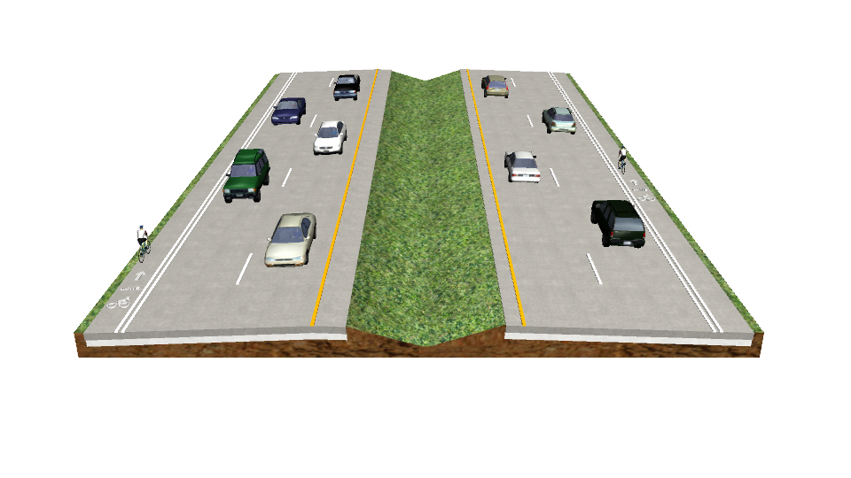
RECOMMENDED BUILD ALTERNATIVE
Widening corridor to 4-lane divided highway
  Exceptions:
    Downtown Plant City (No-Build), Mobley Street to Maryland Avenue
    Design Speed varies from 45 mph
    to 50 mph
    Right-of-way varies from 114 feet
    to 160 feet
Buffered bike-lanes and sidewalks
will be established along the entire
build alternative
Notes:
Recommended improvements include widening the existing highway to four lanes (except through downtown Plant City from Mobley Street to Maryland Avenue) as well as adding paved shoulders to the inside and outside of the travel lanes, and improving sidewalk connectivity.

Slide 14
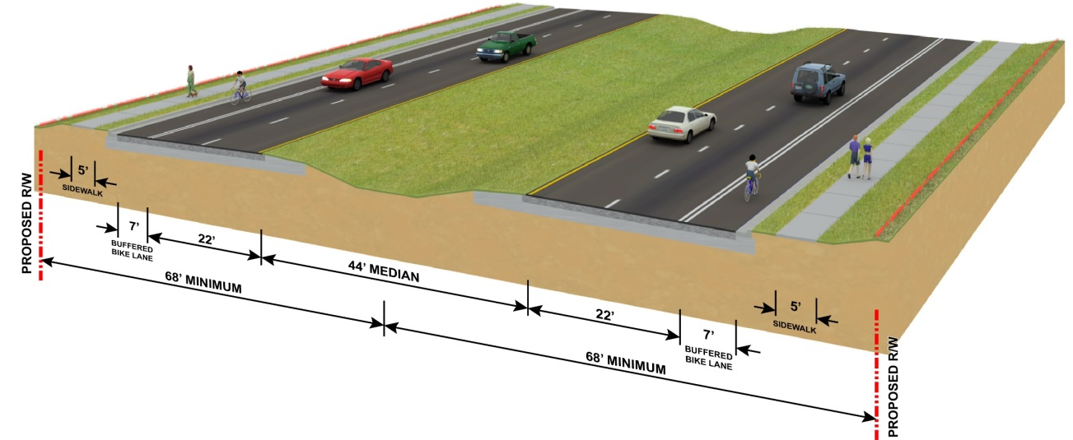
RECOMMENDED BUILD ALTERNATIVE
Segments:
Garden Lane to West of I-75 & East of I-75 to West of Mango Road (widen to north)
West of Mango Road to East of Mango Road (north)
East of Mango Road to North Parsons Avenue (south)
North Parsons Avenue to East of Crow Wing Drive (north)
  45 mph design speed
  136 feet right-of-way
  North and South Alignments
  Urban Roadway
Typical Section 1
Notes:
Typical section 1 shows the recommended build alternative that relates to four segments along US 92. This build alternative consists of an urban roadway with two 11-foot travel lanes, a seven-foot buffered bike lane in each direction, and five-foot sidewalks on both sides of the road. The travel lanes are separated by a 44-foot wide median. Curb and gutter are also used along the outsides lanes. This typical section requires a minimum of 136 feet of right-of-way. The recommended alignments separated by segments are shown on display tonight.

Slide 15
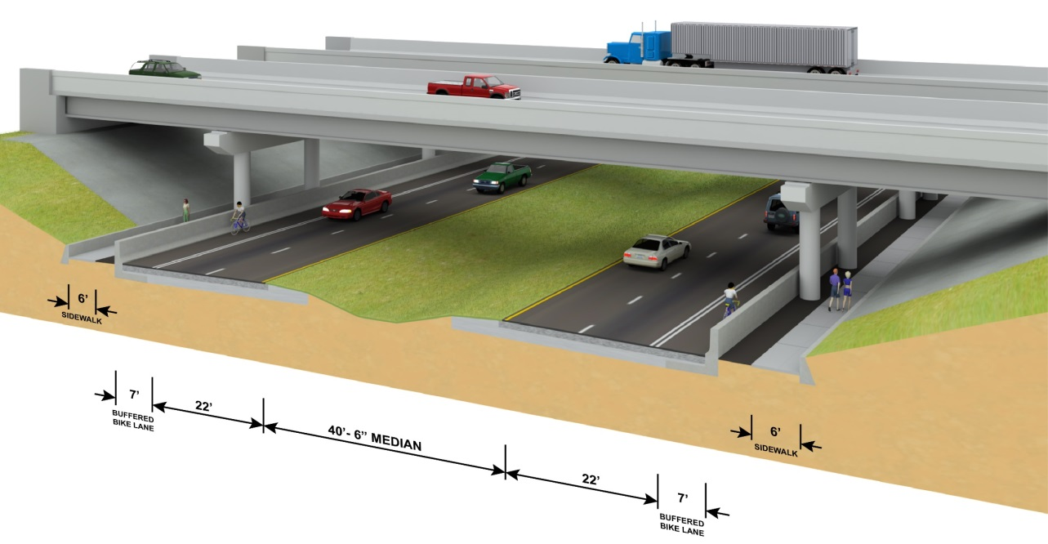
RECOMMENDED BUILD ALTERNATIVE
West of I-75 Overpass to East of I-75 Overpass
45 mph design speed
136 feet right-of-way
North alignment
Urban roadway
Typical Section 2
Notes:
Under the I-75 overpass, the typical section is narrower because of the width between the existing I-75 bridge piers. The recommended build alternative for this segment is two 11-foot travel lanes with a seven-foot buffered bike lane in each direction. The travel lanes are separated by a 40 and a half-foot-wide median. Pier protection barriers are located between the bike lanes and the piers, with six-foot sidewalks located on the outside of the barriers in both directions.

Slide 16
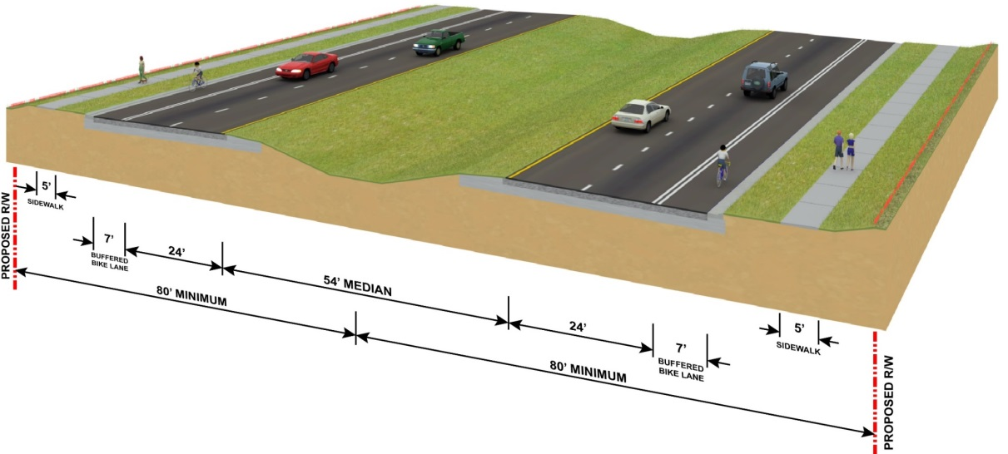
RECOMMENDED BUILD ALTERNATIVE
Segments:
5. East of Crow Wing Drive to Castlewood Road (north)
6. Castlewood Road to West of Gallagher Road (south)
7. West of Gallagher Road to Lynn Oaks Circle (south)
8. Lynn Oaks Circle to East of Bethlehem Road (centered)
9. East of Bethlehem Road to Edwards Street
50 mph design speed
160 feet right-of-way
North, South, and Center
Alignments
High speed suburban roadway
Typical Section 3
Notes:
Typical section 3 involves five segments along US 92 from East of Crow Wing Drive to Edwards Street. The recommended build alternative consists of a high speed suburban roadway with two 12-foot travel lanes, a seven-foot buffered bike lane in each direction, and five-foot sidewalks on both sides of the road. The travel lanes are separated by a 54-foot wide median. Curb and gutter are also used along the outsides lanes.This typical section requires a minimum of 160 feet of right-of-way.

Slide 17
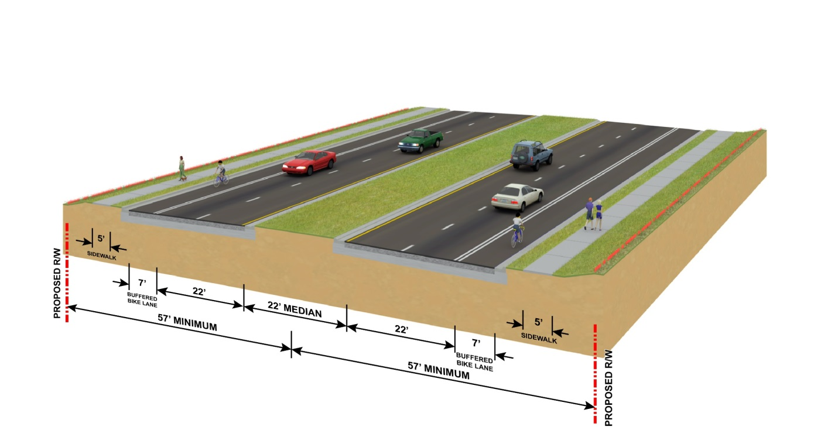
RECOMMENDED BUILD ALTERNATIVE
Edwards Street to Mobley Street
45 mph design speed
114 feet right-of-way
Center Alignment
Urban Roadway
Typical Section 4
Notes:
From Edwards Street to Mobley Street the recommended build alternative is shown in typical section 4. This build alternative is an urban roadway with two 11-foot travel lanes, a seven-foot buffered bike lane in each direction, and five-foot-wide sidewalks. The travel lanes are separated by a 22-foot-wide median. Curb and gutter are along the inside and outside lanes. This typical section requires a minimum of 114 feet right-of-way.

Slide 18
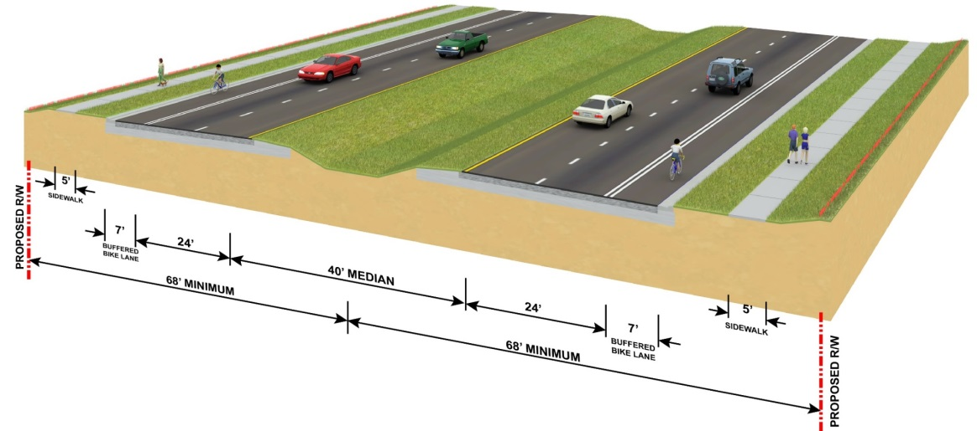
RECOMMENDED BUILD ALTERNATIVE
West of Park Road to County Line Road
50 mph design speed
136 feet right-of-way
North Alignment
High speed suburban roadway
Typical Section 5
Notes:
The recommended build alternative for the segment from West of Park Road to County Line Road is a high speed suburban roadway consisting of two 12-foot travel lanes, a seven-foot buffered bike lane in each direction, and a five-foot-wide sidewalk. The travel lanes are separated by a 40-foot-wide median. This typical section requires a minimum of 136 feet of right-of-way. The recommended build alternatives for this project ends at County Line Road but will tie in to improvements of US 92 located in Polk County that is being proposed by FDOT District One.

Slide 19
ACCESS MANAGEMENT
Combination of directional and full median openings proposed
  Directional median openings allow some turns
  Full median openings allow turns in all directions
Driveway and crossroad locations considered
Access Management Class 5 spacing criteria
Class | Medians | Median Openings |  | Signal | Connection
 |  | Full | Directional |  | More than 45 mph posted speed | 45 mph and less posted speed
5 | Restrictive | 2,640’ At greater than 45 mph | 660’ |  | 440’ | 245’
 |  | 1,320’ At 45 mph or less
Notes:
With any roadway improvements, to install medians providing access to property is always a priority while also meeting acceptable guidelines. Median openings are provided at specific locations to provide access to adjacent properties. The spacing between median openings and traffic signal locations are dictated by the access management classification of the roadway. The proposed median opening types and their locations are shown on the display boards tonight.

Slide 20
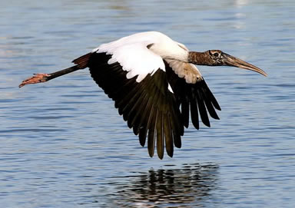



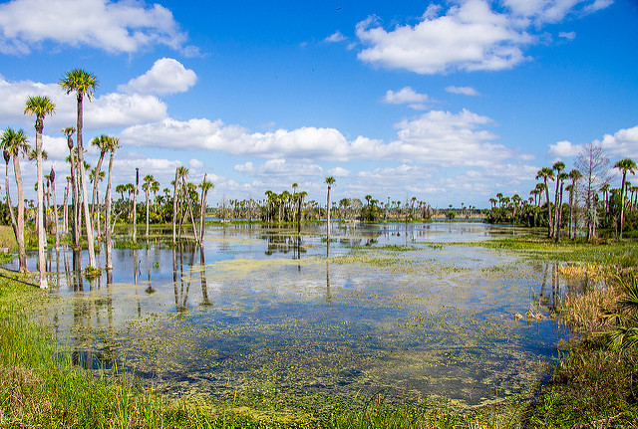


ENVIRONMENTAL STUDIES
This PD&E Study Re-evaluation includes:
Comprehensive evaluation of the proposed improvements
Evaluation of economic, socio-cultural and natural environment effects
Notes:
This PD&E Study Re-evaluation includes evaluation of economic, socio-cultural and natural environment effects. The study team had a chance to evaluate the Natural and Physical effects of the recommended alternative broken down by build segments.
Impacts are anticipated and are consistent with the impacts identified in the original PD&E Study. Details of all project impacts separated by segments are shown on the evaluation matrix displayed tonight.

Slide 21
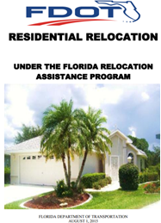
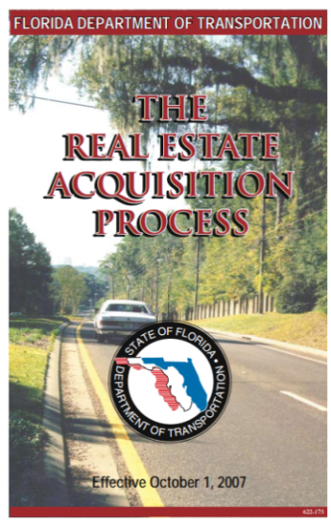
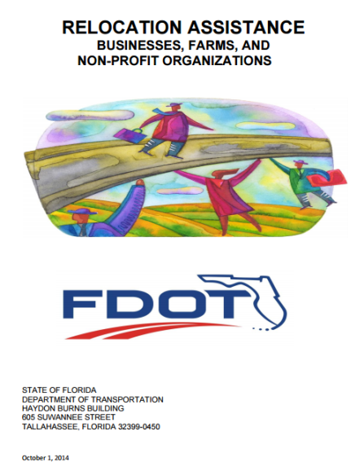
ENVIRONMENTAL STUDIES
SOCIO-ECONOMIC EFFECTS
Potential Relocations
  120 residential relocations
  110 business relocations
  Right-of-way acquisition in accordance with
  Uniform Act
    Relocation Assistance
    Real Estate Acquisition Process
Notes:
One of the unavoidable consequences of a project such as this is the necessary relocation of residences or businesses. On this project, we anticipate the relocation of 120 residential locations and 110 business locations. All right-of-way acquisition will be conducted in accordance with the federal Uniform Relocation Assistance and Real Property Acquisition Act of 1970, commonly known as the Uniform Act.
Informational brochures are available here tonight that describe the Department’s relocation assistance program and right-of-way acquisition program. Representatives from FDOT’s right-of-way office are available here tonight also and can address your questions regarding the real estate acquisition process or you can write to the Department at the address shown in your handout.

Slide 22
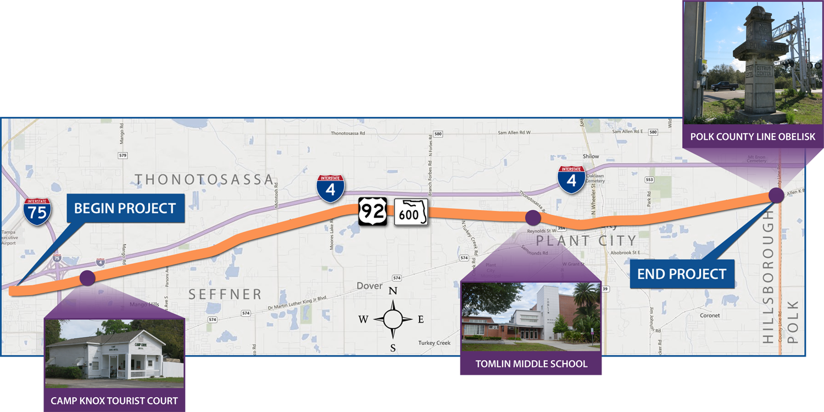
CULTURAL EFFECTS
Cultural Resource Survey Results:
  3 Historical Resources
  No Archaeological Sites
FHWA and State Historic Preservation
Officer Reviewed and Concurred
A Draft Section 106 Case Study Report is Available Tonight
Notes:
Specialists conducted a cultural resource survey in accordance with Chapter 267 of the Florida Statutes and the National Historic Preservation Act of 1966 to identify cultural resources within the project’s area of potential effect. Three historic resources within the build segments have been identified as eligible for the National Register of Historic Places. They include the Camp Knox Tourist Court, Tomlin Middle School, and the Polk County Line Obelisk. No archaeological sites were identified. The State Historic Preservation Officer and Federal Highway Administration concurred with the results of the survey. A Section 106 Case Study Report was prepared to identify any impacts to these historic resources. This draft report is available at this hearing for your review and comments will be accepted.

Slide 23
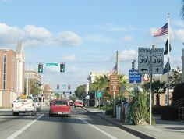
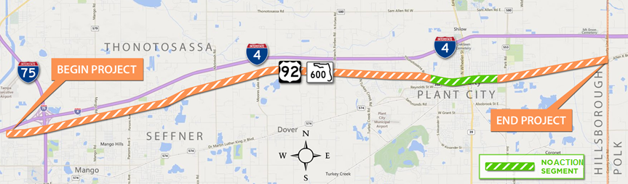
NO-BUILD ALTERNATIVE
Segment runs through Downtown Plant City
  Mobley Street to Maryland Avenue
No improvements - only routine maintenance
No Build
Segment
Notes:
In addition to the recommended build alternative, the no-build alternative relates back to a previously proposed alternative from the original PD&E Study in 1994. The original PD&E Study recommended that the section of US 92, between Mobley Street and Whitehall Street, be converted from a rural roadway to an urban roadway in order to provide sidewalks and drainage enhancements. These improvements were completed for this section and met the intent of the original PD&E Study recommendation. This re-evaluation of US 92 concludes that this segment, from Mobley Street to Maryland Avenue, will remain a no-build alternative. The No-Build alternative assumes that no improvements will be made to that segment of US 92 through the year 2040 except routine maintenance, pavement resurfacing, and safety enhancements as required.

Slide 24
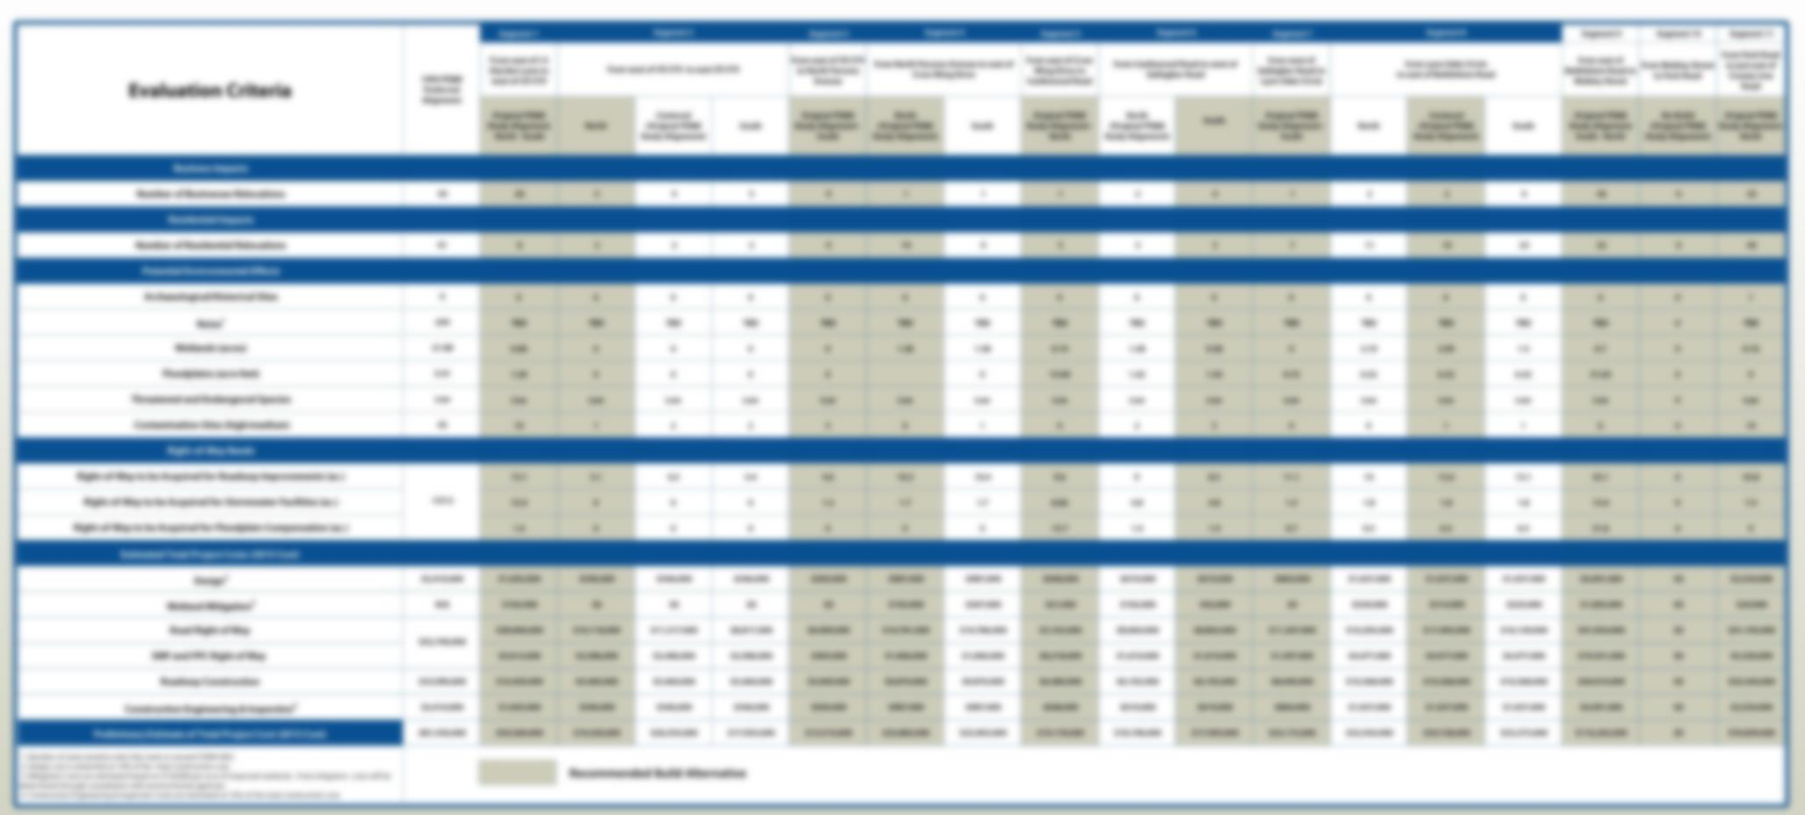
EVALUATION MATRIX
A detailed alternatives comparison matrix is on display tonight
The estimated total cost for proposed improvements is approximately $399 million in today’s dollars
Notes:
The estimated total cost for the proposed improvements to the widening of US 92 is approximately $399 million in today’s dollars. The total cost is broken down by design, right-of-way acquisition, wetland mitigation, construction, and construction engineering and inspection. This chart on display at tonight's hearing shows the impacts and costs split by segment.

Slide 25
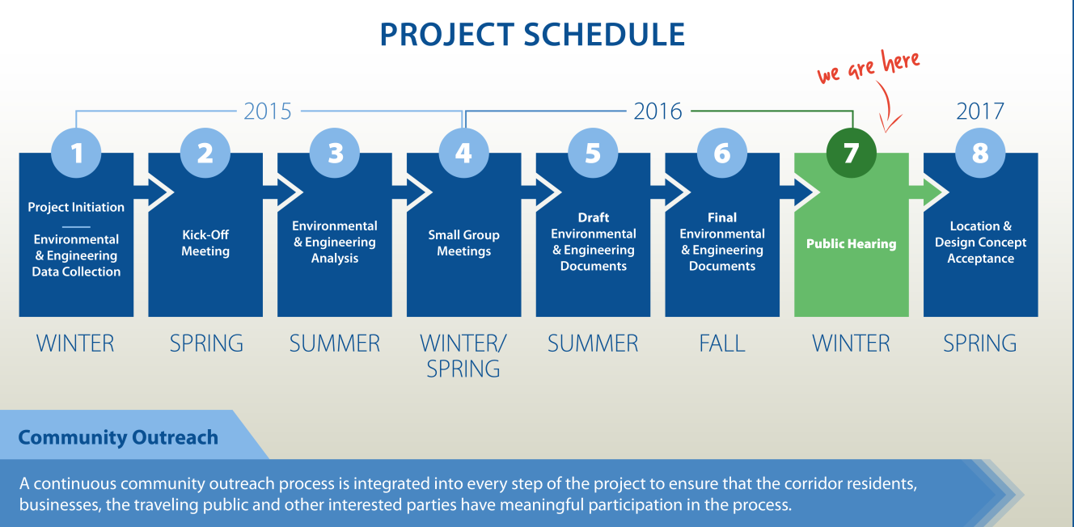
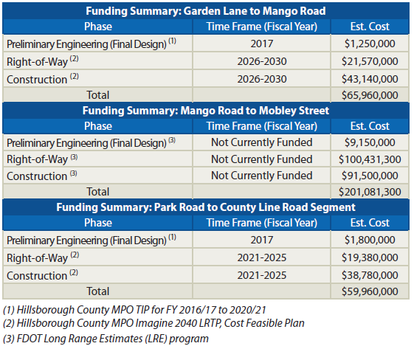
PROJECT STATUS
Design scheduled to begin in Spring 2017
Two segments scheduled for design
  US 92 from Garden Lane to Mango Road
  US 92 from West of Park Road to County Line Road
  Mango Road to Mobley Street is not currently funded
Notes:
The PD&E Study is scheduled for completion in the beginning of 2017, with design scheduled to begin in the spring for the west and eastern segments. The study schedule is on display this evening. FDOT’s 5-Year Work Program includes funding for the design of the four-lane widening of US 92 from Garden Lane to Mango Road and from Park Road to County Line Road in fiscal year 2017. Right-of-way acquisition and construction of the improvements are not currently funded in the 5-Year Work Program.

Slide 26
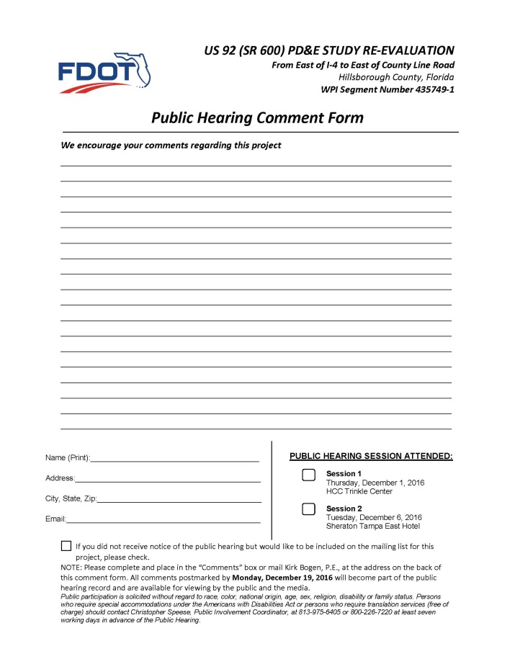
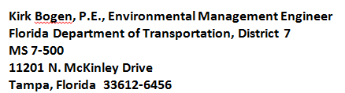
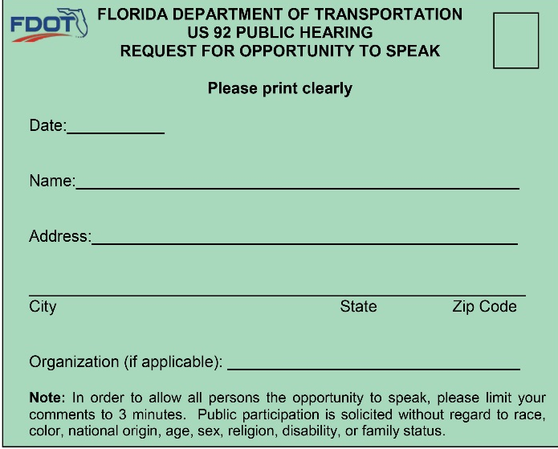
OPPORTUNITIES FOR INPUT
Provide your comments during
the public comment period
Provide your comments directly
to the court reporter at anytime
during this hearing
Complete comment form
  Place in comment box tonight
  Email your comments to:
  lilliam.escalera@dot.state.fl.us
  Mail your comments
  Submit by Monday, December 19, 2016
  to be included in the official hearing record
Notes:
We encourage you to give your feedback on the proposed improvements mentioned tonight. There are several ways to make a comment as part of the public hearing record. To provide comments: You can speak directly with the court reporter at this hearing. You may make a comment during the formal hearing session tonight. You may complete the comment form provided in your brochure and drop it in one of the comment boxes today. You may email the form to lilliam.escalera@dot.state.fl.us. You may make a comment on the project website. Or you may mail written comments to the address listed on the back of the form. All comments must be received or postmarked by December 19, 2016 to become part of the official public hearing record.

Slide 27

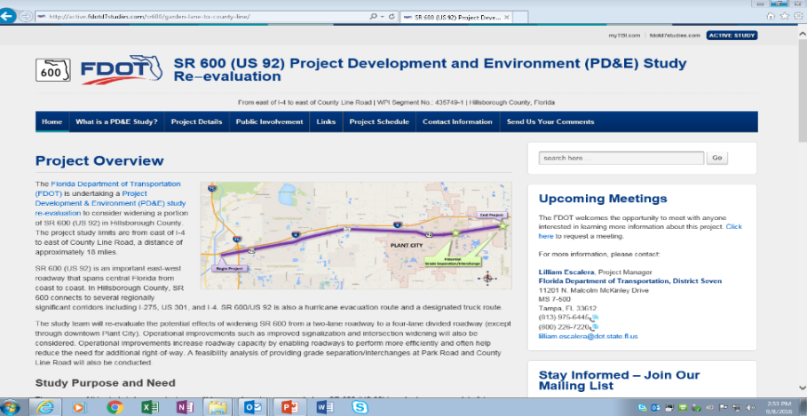
PROJECT WEBSITE
Connect with the project on the web at:
http://active.fdotd7studies.com/sr600/i4-to-county-line/
Notes:
Please visit the project website at the address shown on this slide and as listed in your handout. Here you can find more information on the project; view schedules, and learn about upcoming events.

Slide 28

Thank you for your interest!
For additional information please contact:
Lilliam E. Escalera, Project Manager
Florida Department of Transportation, District VII
Planning & Environmental Management Office (PLEMO)
11201 N. McKinley Dr., 7-800, Tampa, FL 33612
Phone: (813) 975-6445
Lilliam.Escalera@dot.state.fl.us
Remember to be Alert Today, Alive Tomorrow.
Safety doesn’t happen by accident.
Notes:
Thank you for coming out tonight and participating in the US 92 PD&E Study Re-evaluation process. We look forward to your comments and continued interest in this project. Remember to be Alert Today, Alive Tomorrow. Safety doesn’t happen by accident.

Slide 29
Please take time to view the exhibits in the Main Area and provide us your comments.
The video will repeat in 1 minute

Slide 30
Please take time to view the exhibits in the Main Area and provide us your comments.
The video will repeat
in 30 seconds

Slide 31
Please take time to view the exhibits in the Main Area and provide us your comments.
The video will repeat
in 10 seconds

Slide 32
Please take time to view the exhibits in the Main Area and provide us your comments.
The video will repeat
in 5 seconds

